Slide 1
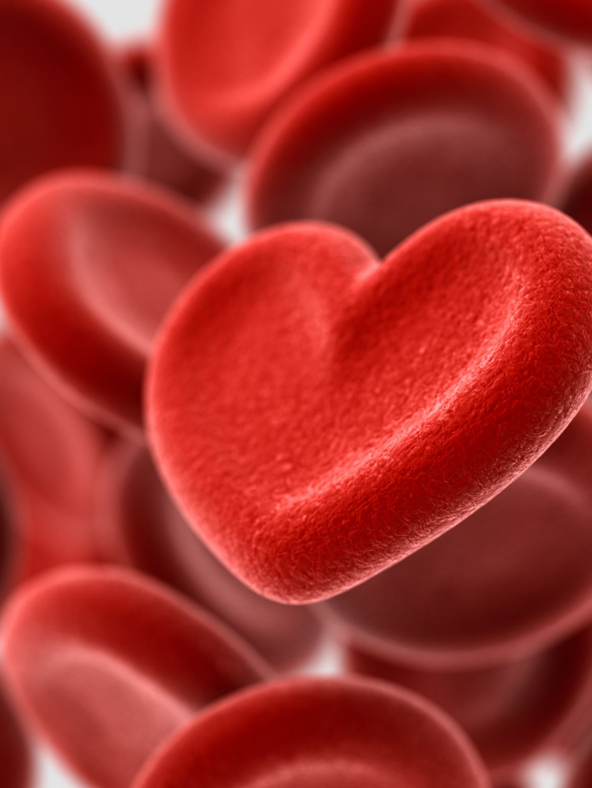

GIVE BLOOD, SAVE LIVES
Info for Senior Cycle

Slide 2
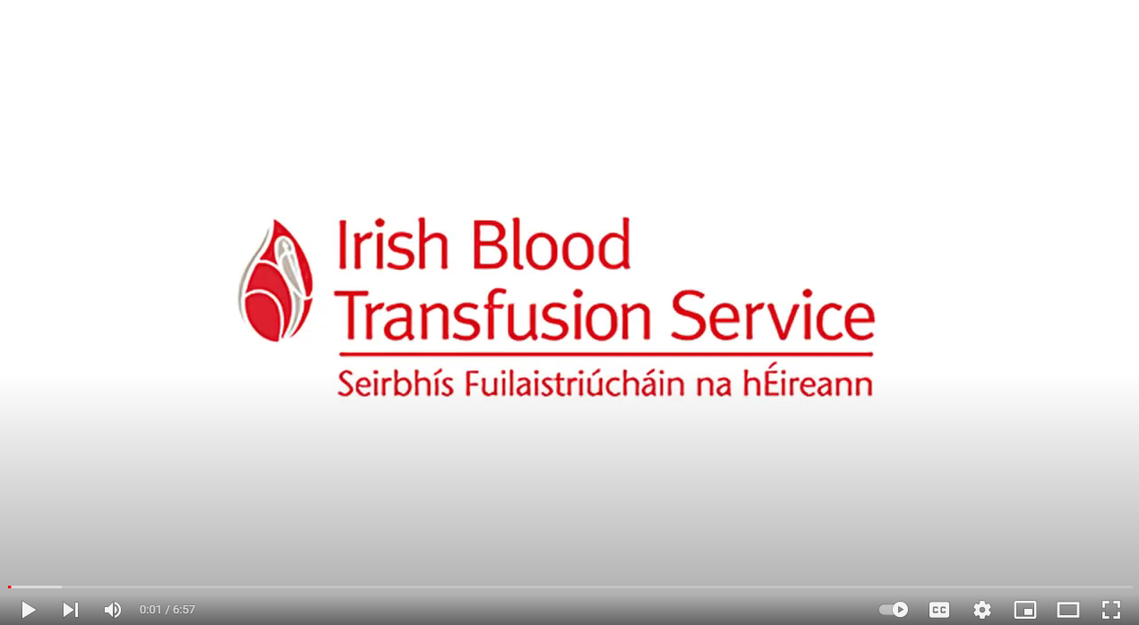
Why Give Blood?
https://youtu.be/VZ3ezg-Uq0Y

Slide 3
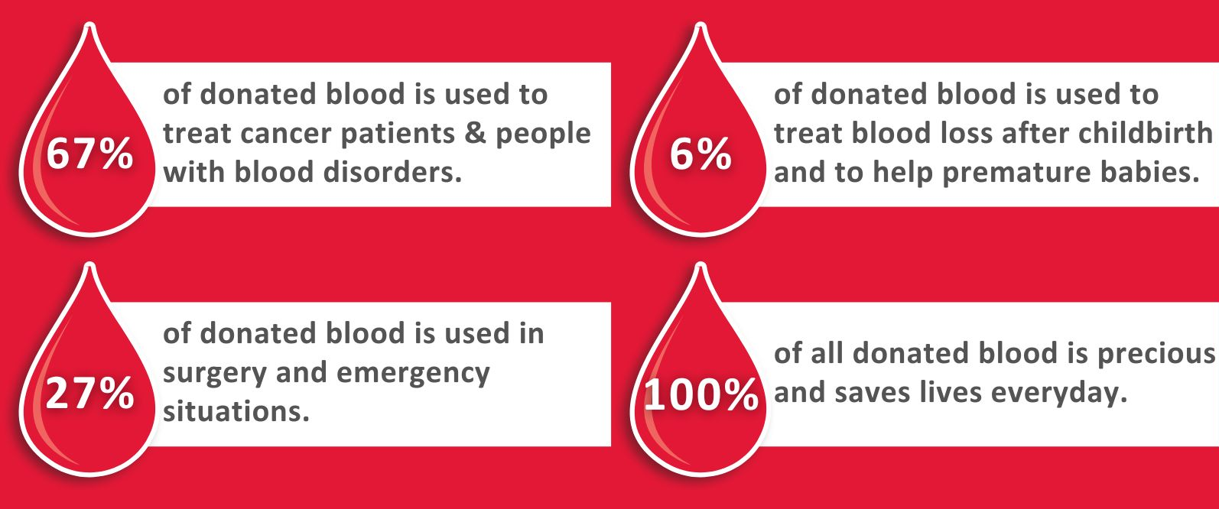
Giving Blood Saves Lives

Slide 4
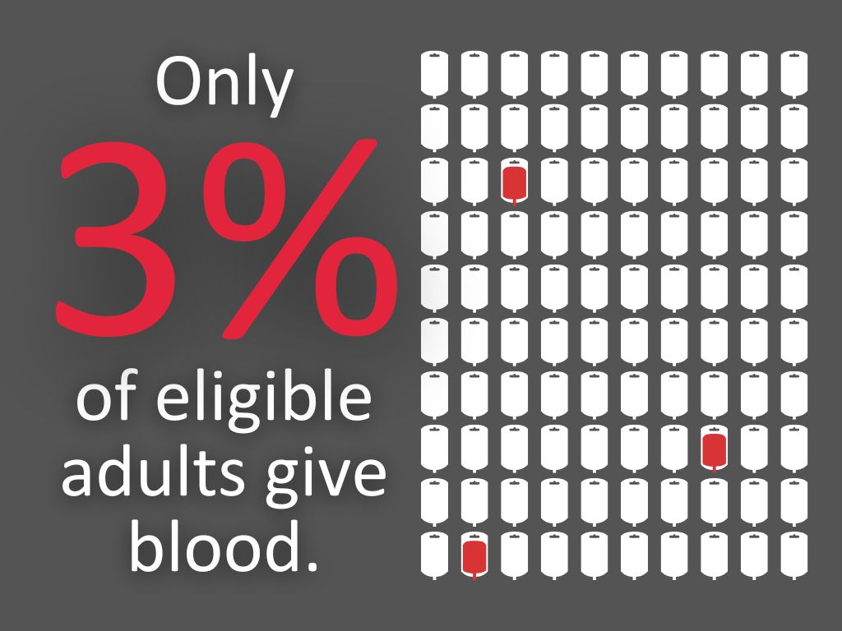

Slide 5
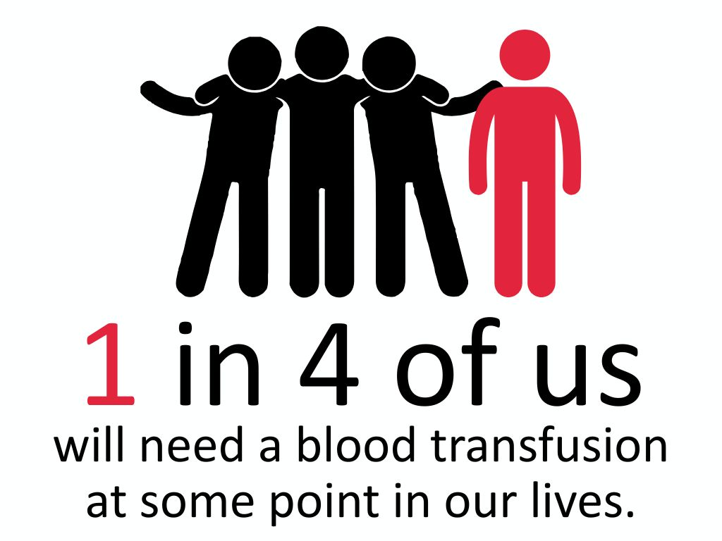

Slide 6
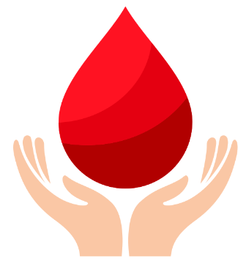
Discuss: Barriers to Giving Blood
What do you think are the reasons why young people do not/cannot give blood?
The reasons why someone might be unwilling to give blood
The medical / lifestyle reasons why people might not be able to give blood

Slide 7
Barriers to Giving Blood
Let’s address some of the most common reasons people are unwilling to give blood.

Slide 8
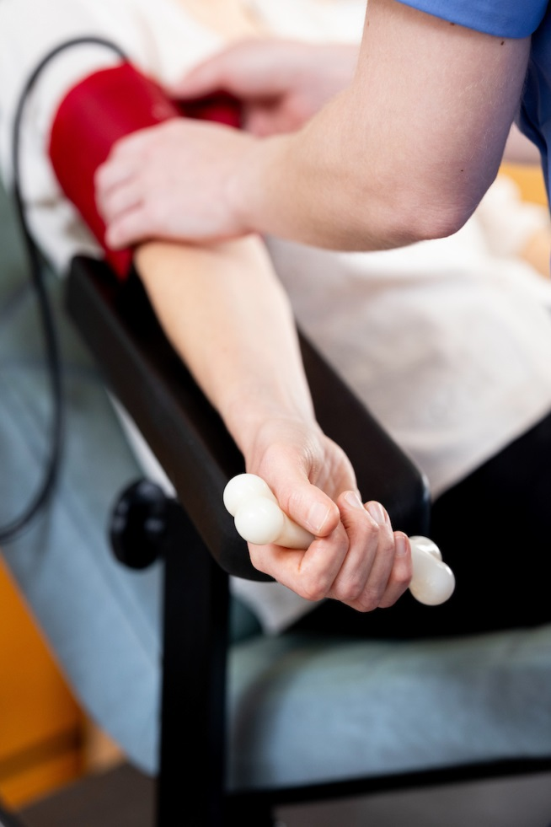
Reason 1: I am afraid of needles
Many people dislike needles, so you're not alone!
Our skilled nursing team cares for donors 130,000 times a year. If you're nervous, let them know, and they'll ensure a quick, comfortable donation.
Bringing a friend can also help ease your experience.

Slide 9
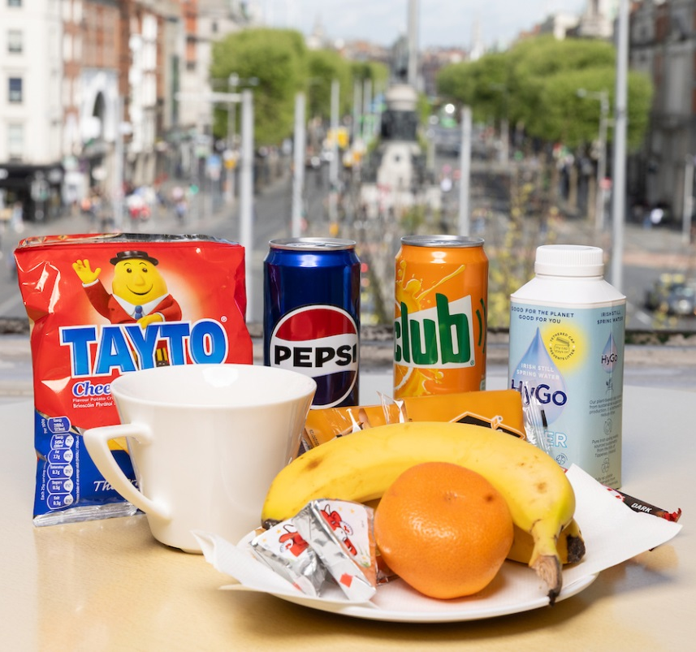
Reason 2: I worry about fainting
To avoid feeling faint when you donate, make sure you eat a good meal within three hours before donating. Drink at least 2 litres of water the day before and on the day of donation.
Eating salty snacks like crisps can really help, our clinics are well stocked!

Slide 10
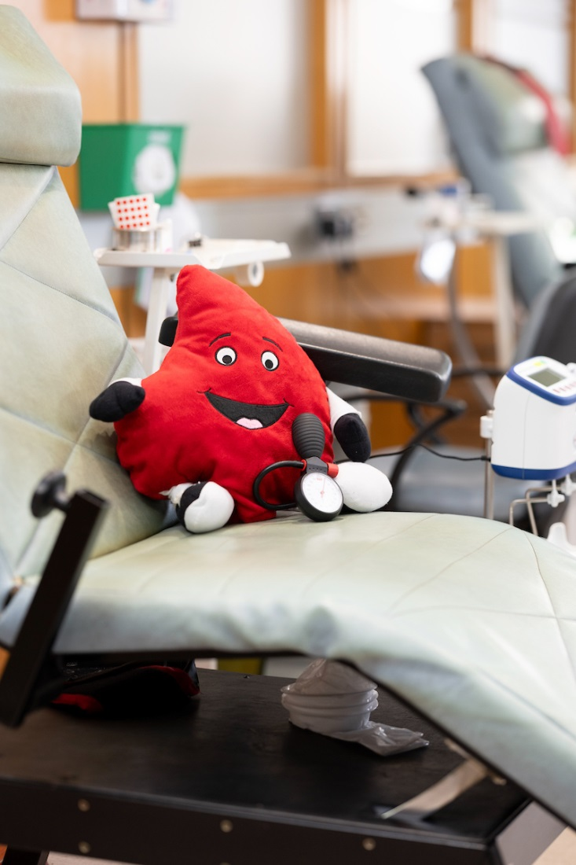
Reason 3: I don’t know how it works
Hopefully, this class and the video will provide you with a clearer understanding of how blood donation works.
For more information, you can visit giveblood.ie or call 1800 731 137.
You can also go to a clinic with someone who has donated blood before to see how clinics work.

Slide 11
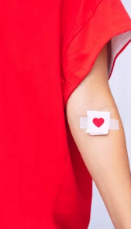
Reason 4: I am too young
Once you turn 18, you’re all set to become part of the blood donor team.
Until then, help promote blood donation! Rally your friends and family to start saving lives.
For some procedures, like bone marrow transplants, products from younger donors can actually result in better outcomes for the patient!

Slide 12

Reason 5: I don’t know my blood type
No worries! When we take your blood, we do a blood grouping test in our labs to find out your blood type. Once we know it, we let you know and keep a record for you.
Plus, after your first donation, we’ll send you a donor card with this info.

Slide 13
Barriers to Giving Blood
Let’s address some of the most common reasons people are unable to give blood.
Here are some common things people think about eligibility to give blood:

Slide 14
You can’t donate if you have a tattoo or piercing…
FALSE!
If you've gotten a tattoo or piercing, you can donate again after 4 months.

Slide 15
Donors who smoke cannot give blood…
FALSE!
A common myth, but completely incorrect. Smoking has nothing to do with blood donation.

Slide 16
Donor might not weigh enough to give blood…
TRUE!
Blood donors must weigh between 50 and 158 kg.
Females or trans-males under 26 may require a blood volume check. If you're shorter than 168 cm and weigh less than 65 kg, we will do a quick calculation to assess your eligibility.

Slide 17
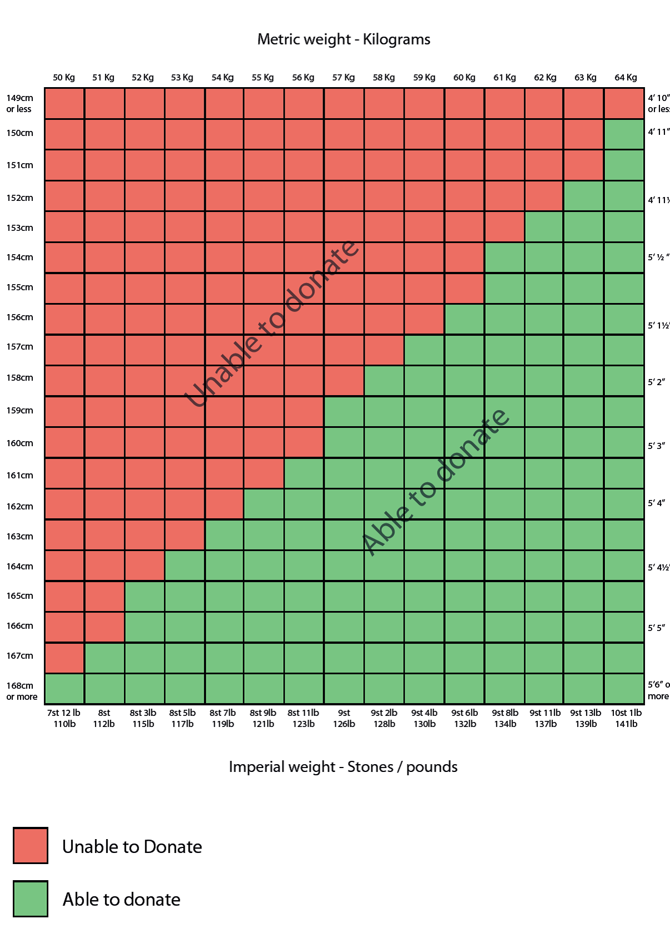
Estimated Blood Volume
This calculation ensures you have enough blood volume for safe donation, similar to ensuring there is enough fuel for a road trip.

Slide 18
LGBTQ+ people cannot donate…
FALSE!
Each donor’s eligibility to donate is assessed on a person-by-person basis in relation to sexual history and risk.

Slide 19
Donors who have had an STI can’t donate…
It depends which Sexually Transmitted Infection!
Visit our website to find specific information about STIs and eligibility.

Slide 20
Donors cannot drink alcohol…
FALSE… but you shouldn’t drink on the day you donate!
Drinking alcohol before or after donating isn't a good idea.
When you're under the influence, you can't give proper consent to donate. Plus, alcohol can dehydrate you, which makes you more likely to faint and feel unwell.

Slide 21
Donors cannot donate if they have ever taken drugs…
FALSE… unless they have injected drugs.
If you've taken non-prescription drugs, you can't give valid consent to donate. How long you need to wait before donating depends on the type of drug and how it was used.
If you've ever used injected drugs, you can't donate at all.

Slide 22
Donors who have travelled or lived abroad cannot donate…
FALSE… but sometimes temporarily TRUE!
Depending on where you've been, you might need to wait a bit—anywhere from 28 days to a year before you can donate blood again. Travel to certain countries outside of Ireland can increase the risk of spreading illnesses like Malaria, the Zika Virus, or even the West Nile Virus to already sick patients.
Check out our website for all the details.

Slide 23
Donors who lived in the UK cannot give blood…
FALSE!
This used to be the case, but changed in 2019! Many people still don’t know, so please tell your parents and help spread the word.

Slide 24
Donors who had jaundice cannot give blood…
FALSE!
This is more likely to have affected your parents, but if you had jaundice before you turned 13, then you’re good to go.

Slide 25
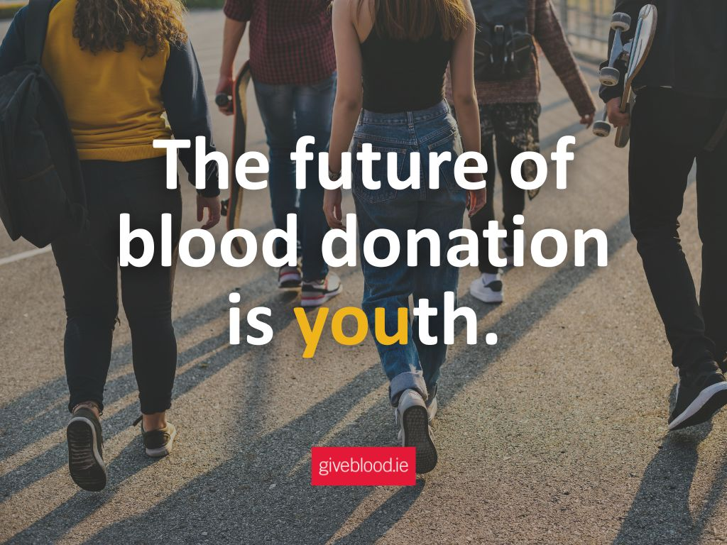
Ireland Needs More Young Donors!

Slide 26
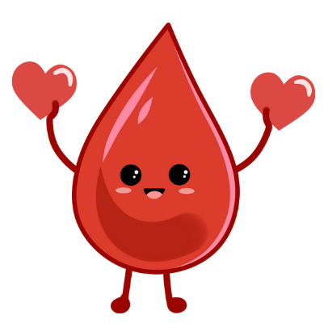
What would encourage you to give blood?
Discuss ideas - Awareness, education, clinic information, convenience etc.

Slide 27
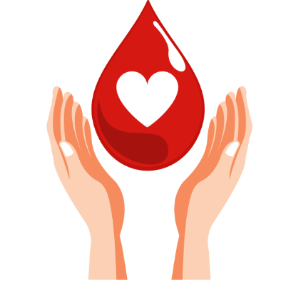
How can you encourage others to give blood?
We can all be blood donation ambassadors!
What can we do to increase the number of adults who give blood from only 3%?

Slide 28
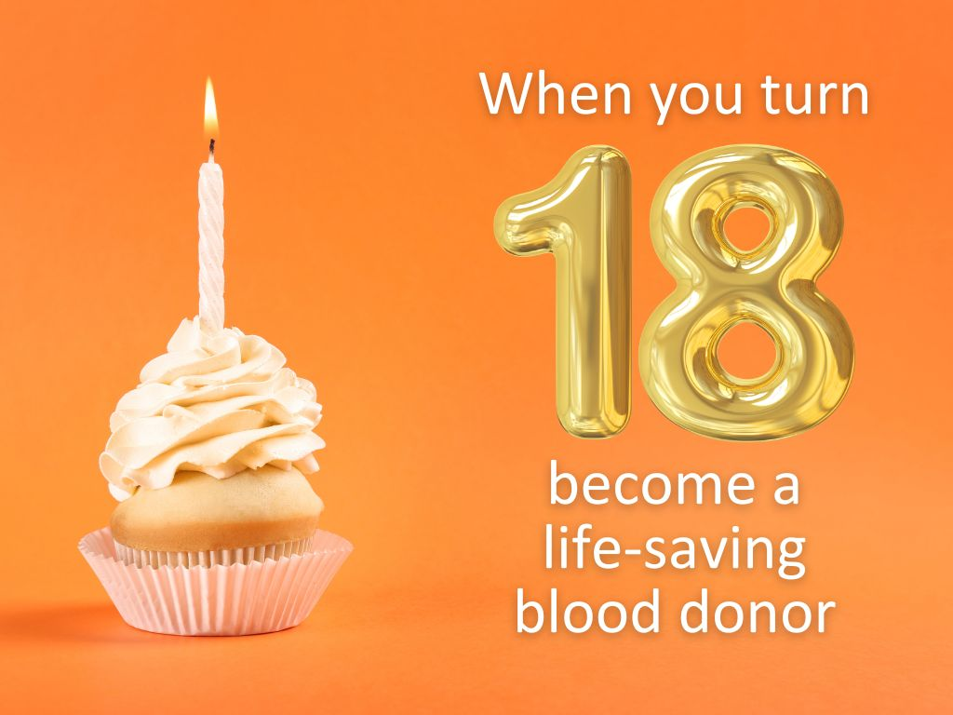

Slide 29
Carlow GAA Give Blood
https://www.youtube.com/watch?v=nbtz69ebyMM

Slide 30


Slide 31
How many units of blood are needed every week? (A unit is approximately 500ml)
300 units
3,000 units
5,000 units

Slide 32
What is the maximum number of days, blood can be used after its collection?
35 days
15 days
90 days
Blood for transfusion is not frozen, therefore it must be used within 35 days of being collected from a donor. Demand from hospitals is such that most blood is often used within 7 days.
For some patients such as very young children and babies, the blood used must be no older than 5 days after collection.

Slide 33
Which treatments/illnesses best describe what hospitals might use blood for most, when they transfuse a patient?
Cancer, anaemia
and blood disorders
Cardiac and
emergency surgery
Maternity / childbirth
treatments
67% of blood transfused is used to treat patients with cancer, anaemia & blood disorders.
27% is used in emergencies and surgery.
6% is used during childbirth for both the parent and baby.

Slide 34
You must be over 18 to donate. True or False?
True
False

Slide 35
How long must you wait after getting a tattoo before you can give blood?
1 month
4 months
12 months

Slide 36
Donors must not eat before giving blood. True or False?
True
False
Donors should eat a meal in the 3 hours before donating, and drinking plenty of cold, non-alcoholic drinks in the 24 hours before donation.
This reduces the likelihood of feeling faint during or after donation.

Slide 37
How often can a person donate blood in Ireland?
Every 35 days
Every 90 days
Every 12 months
You can donate platelets every 28 days, at special clinics, as the process for platelets is different with blood returned to your body after the platelets are extracted during the donation process.

Slide 38
How much blood is taken during a blood donation?
Approx. 120 mls
Approx. 470 mls
Approx. 1 Litre
That is a bit less than a pint.

Slide 39
How many ‘units’ of blood does the average human have in their body? (A unit is 470ml.)
4-6
10-12
14-16
Your blood is about 7% of your body weight!

Slide 40
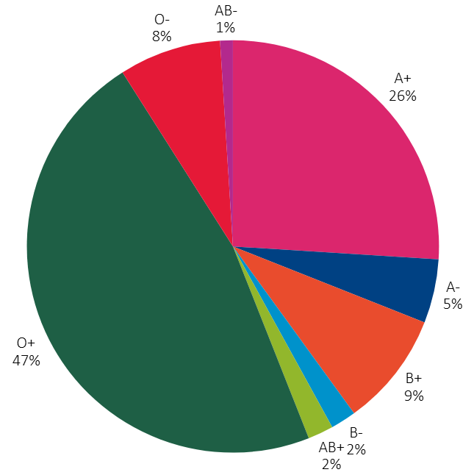
What is the most common blood group in Ireland?
O+
A+
B+
O+ with 47% of the population.
A+ is 26%, B+ is 9%, O- is 8%, A- is 5%, B- is 2%, AB+ is 2%, and AB- only 1%

Slide 41
What Red Cell blood group can be given to all other groups? (I.e. The Universal Donor)
A-
AB-
O-

Slide 42
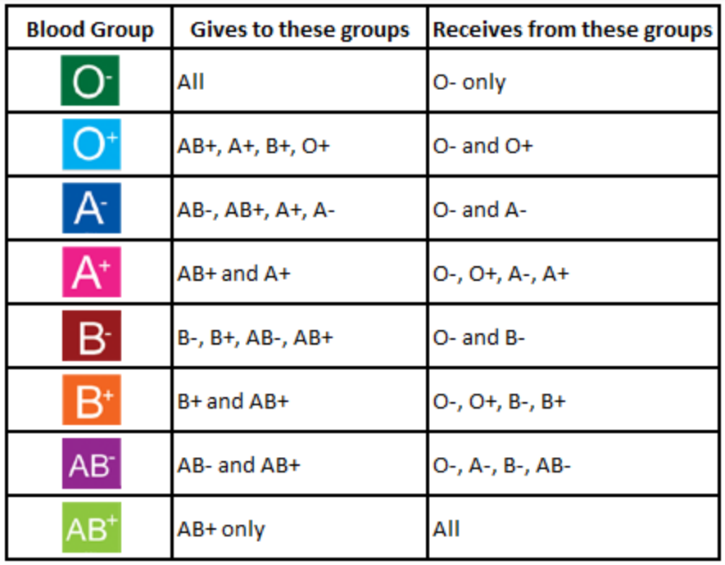

Slide 43
How many patients a year receive a Blood transfusion in the Republic of Ireland?
7,000
17,000
70,000
Nearly 1,400 people per week!

Slide 44
What percentage of people will need a blood transfusion in their lifetime?
5%
(1 in 20 of us)
10%
(1 in 10 of us)
25%
(1 in 4 of us)
They could be your family, your friends, your neighbours, your favourite artist!

Slide 45
What percentage of the eligible population are active donors?
3%
10%
30%
We really need to increase this number, and younger donors are very underrepresented!

Slide 46
How many lives can 1 donation save?
1 life
2 lives
3 lives
That’s because we can split each whole blood donation into 3 different life-saving products. Red cells, platelets, and plasma!

Slide 47
