Slide 1
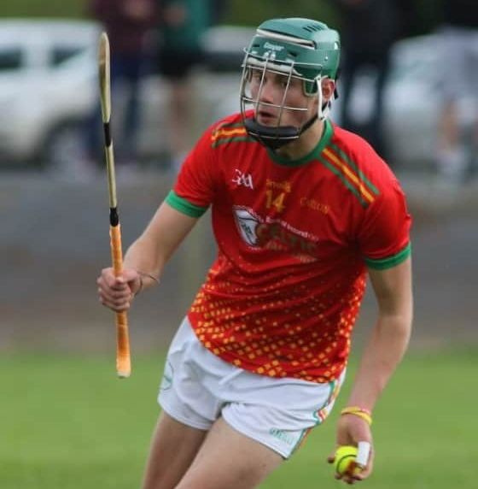

OISIN’S CAMPAIGN
EVERY DROP COUNTS
YOUNG BLOOD DONORS NEEDED

Slide 2
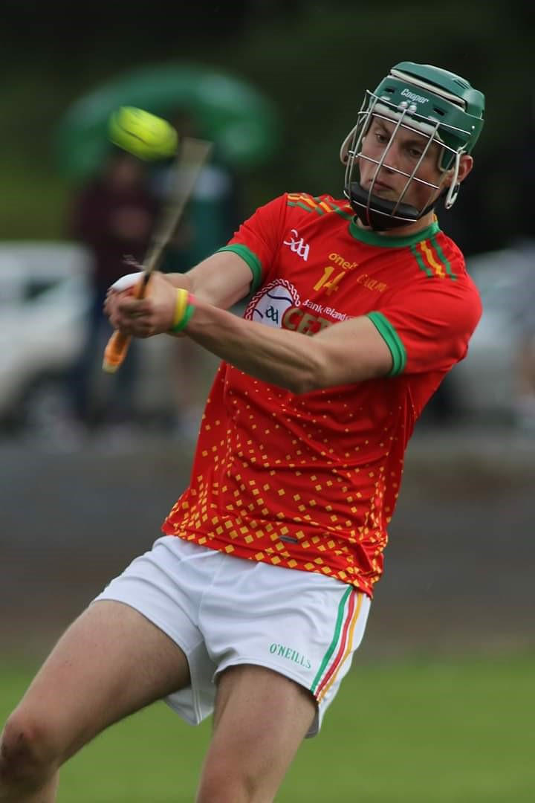
EVERY DROP COUNTS
supports
OISIN’S CAMPAIGN
to recruit new blood donors!

Slide 3
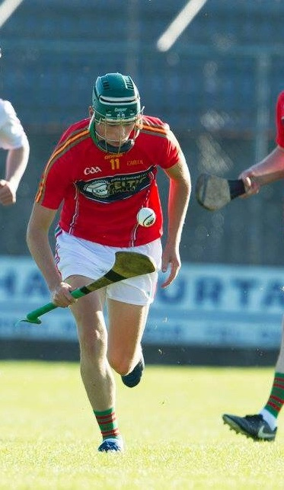
EVERY DROP COUNTS
supports
OISIN’S CAMPAIGN
to recruit new blood donors!

Slide 4
OISIN’S CAMPAIGN
EVERY DROP COUNTS
Our club supports the blood donation clinic in

Slide 5
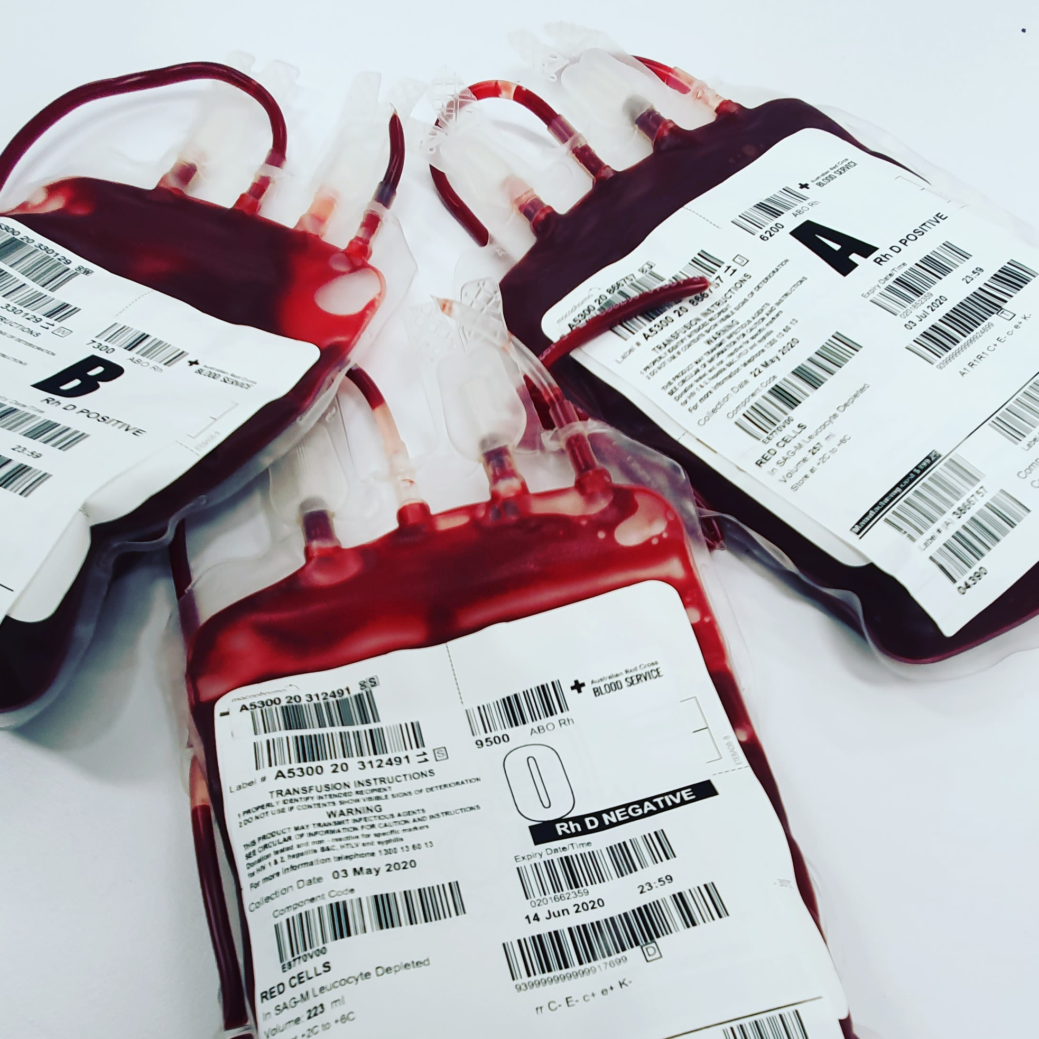

OISIN’S CAMPAIGN
EVERY DROP COUNTS
Become a blood donor today
1800 731137
Give Blood.
Save Lives.

